Slide 1
Pandas: Data Structures, Reading and Writing

Slide 2
Basic introduction
Pandas is a Python library for data analysis and manipulation. It provides data structures such as Series and DataFrame, along with functions for reading and writing data from files and databases..
Python IDE (Integrated Development Environment): Jupyter Notebook or Spyder.
Pandas can be installed with package managers such as pip or conda.
Primary data structures on which all transactions are centred (generally made during the analysis):
  Series: is a one-dimensional data structure labelled array (each value can have an index label).
  Dataframes: More complex data structure designed to contain cases with several dimensions.

Slide 3
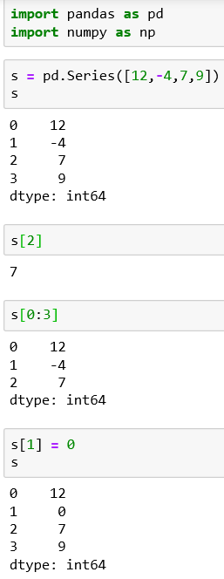
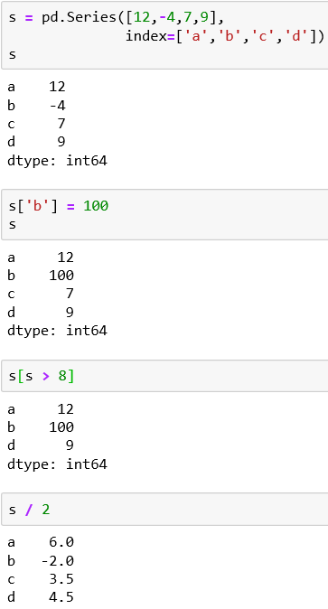
The Series
Declaring a series, assigning an index
Declaring a series
Assigning a value to an item using its label
Selecting one internal element
Selecting multiple elements
Filtering values
Assigning a value to an item using its index.
Operators (+,-,* and /) and mathematical function that are applicable to NumPy array can be extended to Series

Slide 4
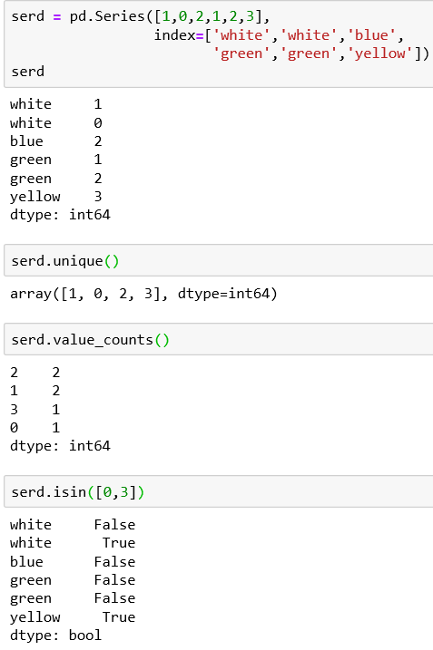
The Series – Evaluating Values
The unique() function will tell us all the values contained in a series, excluding duplicates. It returns the distinct values in the Series.
The value_counts() function returns the number of occurrences of each distinct value.
The isin() function returns a Boolean Series indicating whether each value is contained in a given set/list of values.

Slide 5
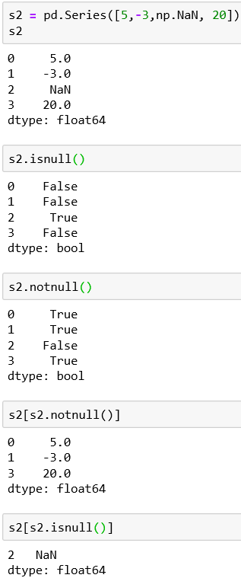


The Series – NaN Values
Missing values in Pandas may be represented by NaN, None or pd.NA, depending on the data type.
NaN (Not a Number) is commonly used in pandas data structures to indicate the presence of an empty field or a non-numeric element. To define a missing value, we can enter np.NaN. Or None
The isnull() (new name isna()) and notnull() (new name notna()) functions are useful to identify the indexes without a value.
The isnull() returns True at NaN values in the series.
The notnull() returns True if they are not NaN.
These functions are often put inside filters to make a condition

Slide 6
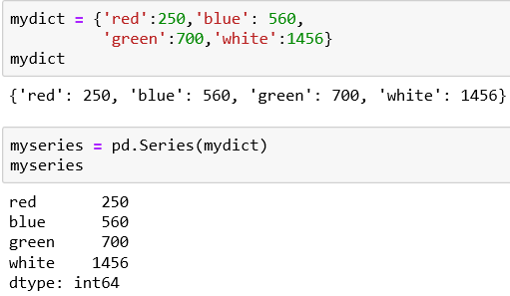
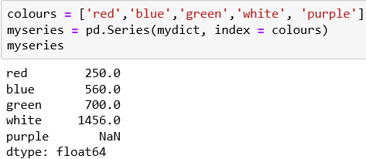
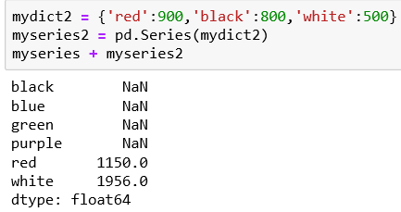
The Series
We can create a series from a previously defined dictionary. The array of the index is filled with the keys while the data are filled with their values.
We can also define the array indexes separately. As seen, if there is a mismatch, pandas will add the NaN value.
We can perform operations between two series. Series can align data addressed differently between them by identifying their corresponding labels.

Slide 7
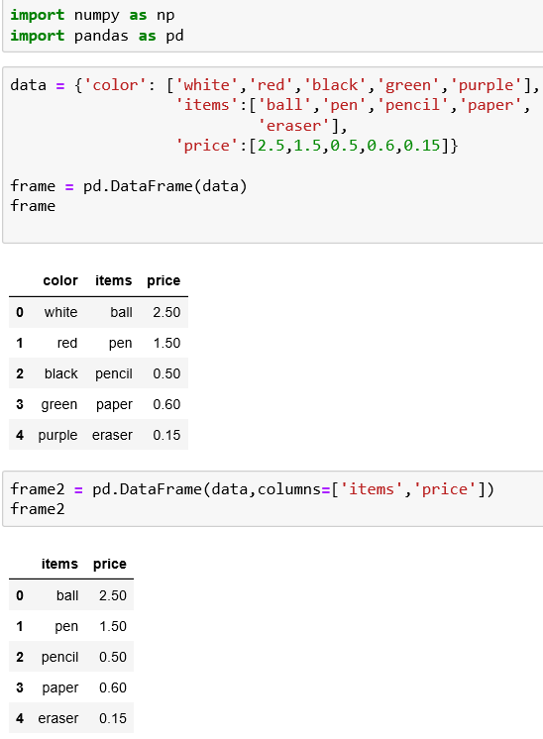
The DataFrame
Two-dimensional labelled tabular data structure with rows and columns, very similar to a spreadsheet.
Designed to extend series to multiple dimensions.
Consists of an ordered collection of columns, each of which can contain a value of a different type (numeric, string, Boolean, etc.)
Unlike series, which have an index array containing labels associated with each element, the dataframe has labels (its index) and column labels.
It can be understood as a dictionary of series where the keys are the column names and the values are the series that will form the columns of the dataframe
Define a dataframe
We can select the data we want to display. Use column option to specify the sequence of columns. dataframe

Slide 8
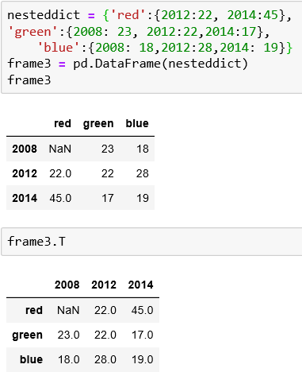
The DataFrame
A common data structure used in Python is a nested dict. When it is passed directly as an argument to the DataFrame() constructor, pandas will treat external keys as column names and internal keys as labels for indexes.
Fields with no match are assigned the NaN value.
Transposition: columns become row and rows become columns. It is achieved by adding the T attribute to its operation

Slide 9
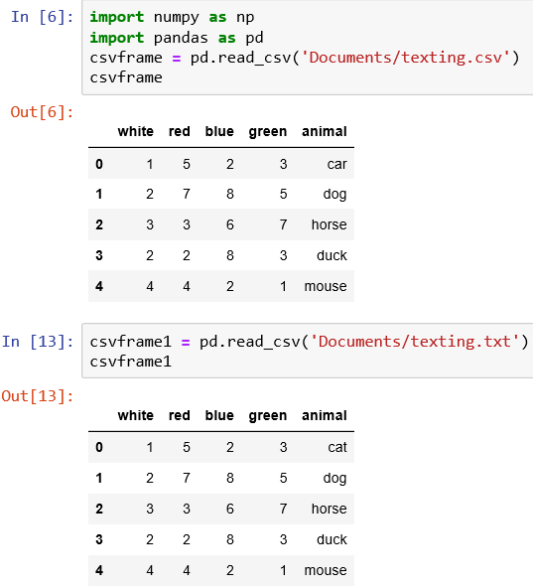
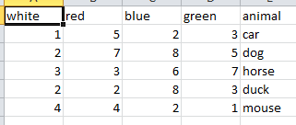
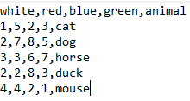
Reading Data in CSV or Text files
Most common operation for data analysis is to read the data contained in a .CSV file of even a text file.
Import Pandas before using read_csv()
The read_csv() function will read the content of the .csv file and convert it to a dataframe object.
Original texting.csv and texting.txt files as seen in the spreadsheet and notepad

Slide 10
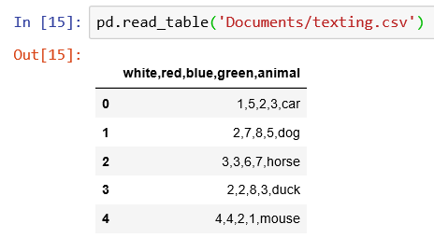
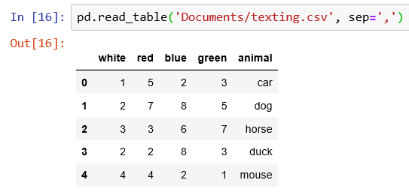
Reading Data in CSV or Text files
pd.read_table() assumes tab-separated data by default. Use the sep parameter when the file uses another delimiter.
Output of read_table() function with specified delimiter
Output of read_table() function without specifying the delimiter

Slide 11

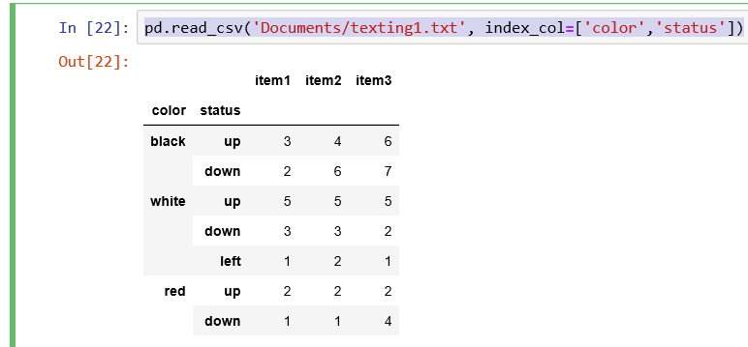
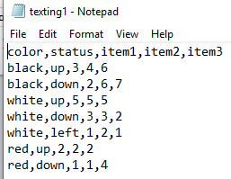
Reading Data in CSV or Text files
pd.read_csv('Documents/texting.csv', header=None): means the file is treated as having no header row, and Pandas assigns default integer column names.
You can specify the names directly by assigning a list of labels to the name options
Create a dataframe with a hierarchical structure by extending the functionality of the read_csv()function by adding the index_col option.
Original Hierarchical data

Slide 12
Using RegExp to Parse TXT files
Sometimes the files on which to parse the data do not show separators such as comma or a semicolon.
Regular expressions can be used as criteria for value separation.
. | Single character, except newline
\d | Digit
\D | Non-digit character
\s | Whitespace character
\S | Non-whitespace character
\n | New line character
\t | Tab character
\uxxxx | Unicode character specified by the hexadecimal number xxxx

Slide 13
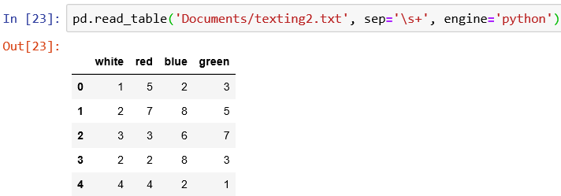
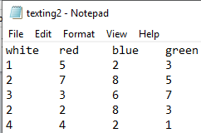
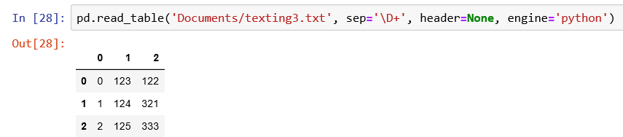
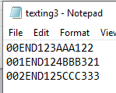
Using RegExp to Parse TXT files - Examples
This example extract the numeric part from a texting3.txt file. Header option = None because the column heading is not in the texting3.txt file.

Slide 14
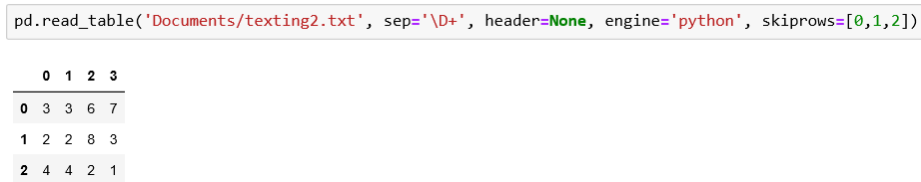
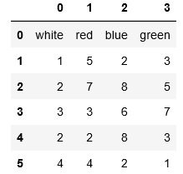
Using RegExp to Parse TXT files - Examples
With the skiprows option, you can exclude the lines you want.
Original texting2.txt file dataframe
texting2.txt file dataframe after skipping the first three rows

Slide 15
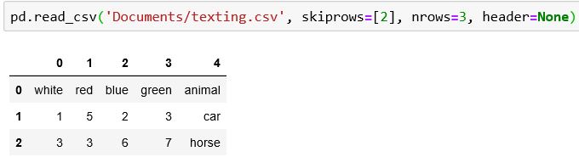
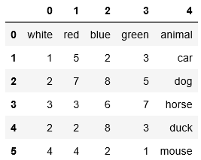
Reading TXT Files into Parts
To read only a portion of the file, you can specify the numbers of lines on which to parse. You can use the nrows and skiprows options.
Original dataframe
Dataframe after using nrows and skiprows

Slide 16
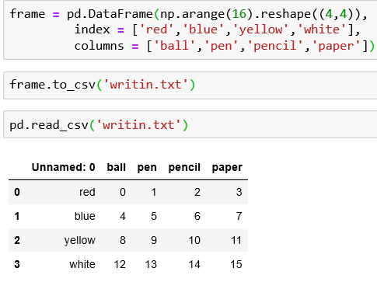
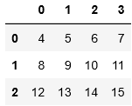
Writing Data in CSV
to_csv(): Function used to write the data contained in a dataframe to a csv file.
Use index=False if you do not want the DataFrame index written to the CSV. Use header=False if you do not want column names written.

Slide 17
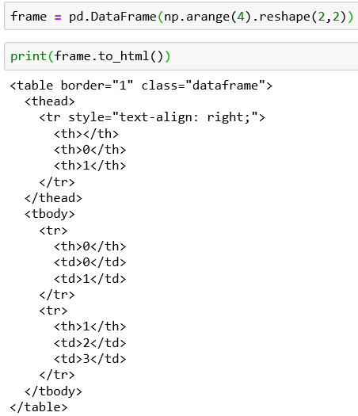
Reading and Writing HTML & Excel Files
to_html() function will convert a dataframe into an HTML table.
read_html() function returns a list of dataframes because a web page can contain multiple tables.
to_excel() function to convert a dataframe into a spreadsheet on Excel.
read_excel() read the data contained in the excel file and convert it into a dataframe

Slide 18

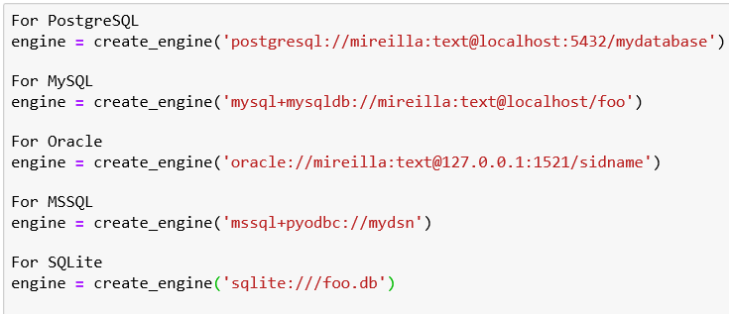
Interacting with Databases
Pandas can read from and write to SQL databases. SQLAlchemy can be used to create database connections for many database systems.
The create_engine() function is used to make a connection. Pandas functions such as: pd.read_sql() or df.to_sql() can then work with that connection.
Example code for connecting to different databases.

Slide 19
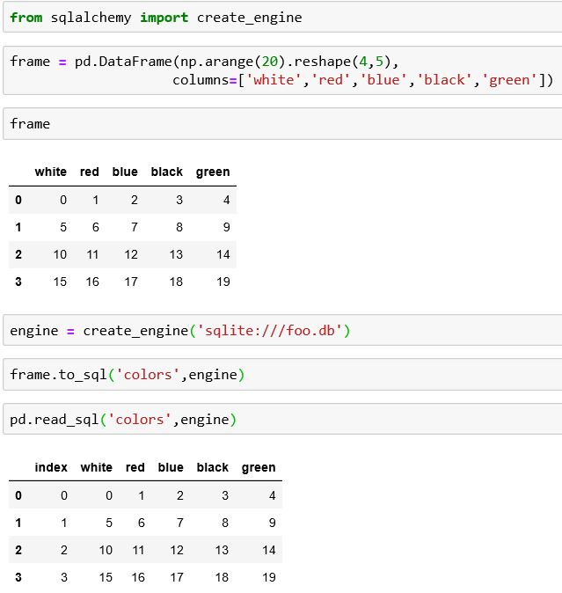
Interacting with Databases – SQLite3
Create a dataframe that will be used to create a new table on the SQLite3 database
Implement the connection to the SQLite3 database
Convert the dataframe
Read the database with the read_sql() function with the name of the table and the engine

Slide 20
SQLite Interaction
import sqlite3
import pandas as pd
conn = sqlite3.connect("students.db")
df.to_sql(
"students",
conn,
if_exists="replace",
index=False
)
result = pd.read_sql(
"SELECT * FROM students",
conn
)

